Slide 1

CS 670
AI Mavericks
Real-Time Weapon Detection System Using YOLOv8
Deep Learning for Public Safety & Security

Slide 2


Who are the AI Mavericks?
Emmanuel Chiobi
Veekshitha Beladara Nanjegowda
Sai Shashank Pannala
Ishita Manish Kulkarni

Slide 3
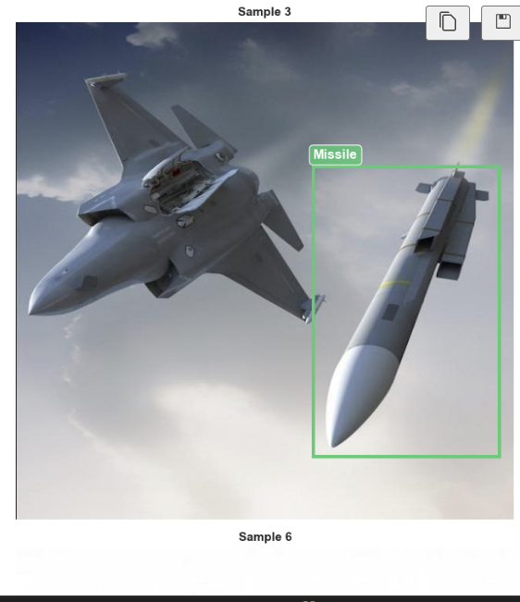
The Challenge: Automated Weapon Detection
The Problem
The Solution
Manual surveillance is time-consuming and error-prone
AI-powered automatic weapon detection enables real-time threat identification in public spaces, dramatically improving security response times and accuracy.
Human operators miss 40-60% of threats in video surveillance
Rising security concerns at airports, schools, public venues

Slide 4
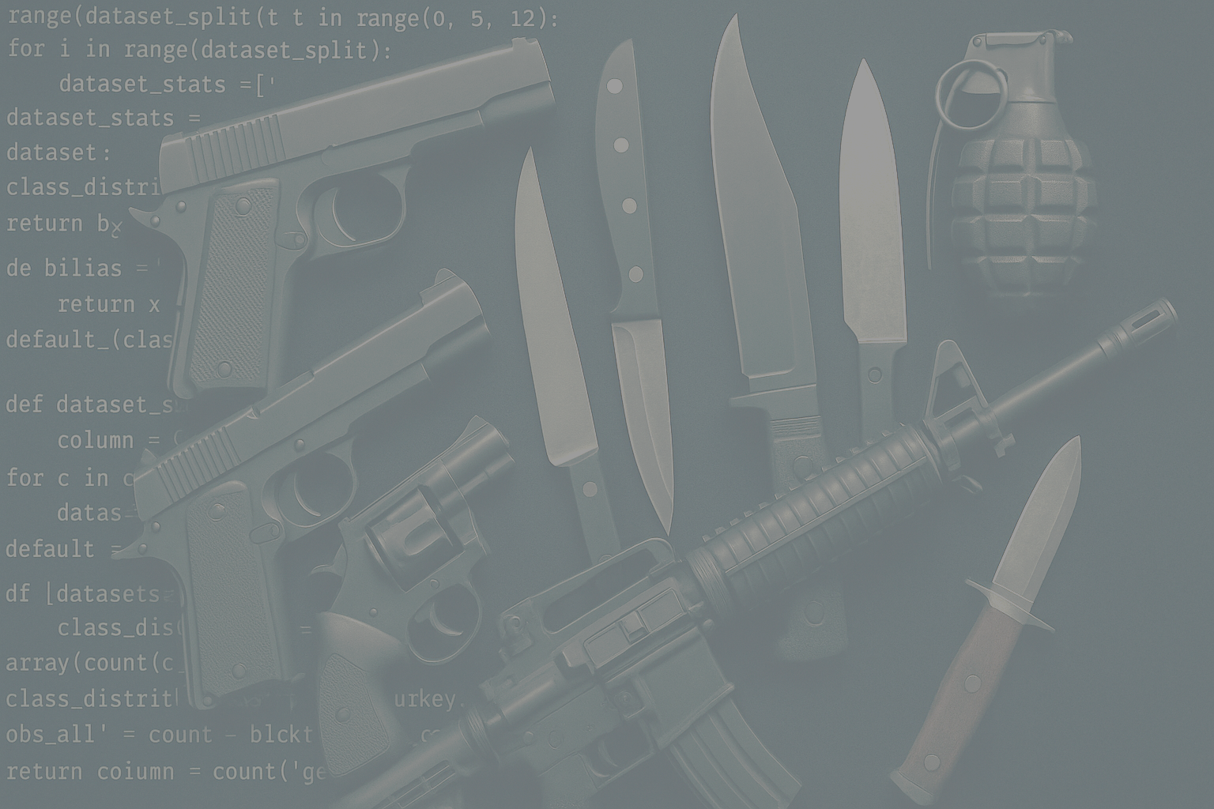





Roboflow Weapon Detection Dataset
9,633
7,182
1,815
636
Total Images
Training Set
Validation Set
Test Set
Comprehensive dataset for training
74.6% of total dataset
18.8% for model tuning
6.6% for final evaluation
Grenade
Knife
Missile
Pistol
Rifle
Source: Roboflow Universe (CC BY 4.0 License)

Slide 5

Dataset Preprocessing & Quality
Image Processing
Annotation Details
Standardized Size: 640×640 pixels
Format: YOLOv8 (YOLO format)
Format: JPEG/JPG
Total annotated objects: 2,963+ in validation set
Auto-orientation applied
Bounding box normalization: 0-1 scale
EXIF data stripped
No augmentation applied
Resize method: Stretch
Quality: Verified and clean annotations

Slide 6
Understanding the Dataset: Key Insights
Bounding Box Sizes
Object Scale Variance
Mean width: 29.8% of image
Smallest object: 0.9% of image
Mean height: 26.7% of image
Largest object: 99.4% of image
Mean area: 9.1% of image
Wide range enables multi-scale detection
Image Consistency
Annotation Quality
100% uniform dimensions (640×640)
7,182 training labels verified
All images properly preprocessed
YOLO format validated
No corrupted files detected
Ready for training

Slide 7


YOLOv8 Nano: Speed Meets Accuracy
Model Specifications
Why YOLOv8n?
Model: YOLOv8n (Nano - fastest variant)
Architecture: 72 layers, 3,006,623 parameters
Optimized for real-time detection with minimal computational overhead while maintaining high accuracy.
Computational Cost: 8.1 GFLOPs
Pre-trained: COCO dataset (80 classes, 1.5M images)
Transfer Learning Strategy: Full model fine-tuning
Transfer Learning: Leveraging COCO pre-trained weights for faster convergence and improved performance

Slide 8




Training Setup & Hyperparameters
Hardware
Training Parameters
Tesla P100-PCIE-16GB GPU by Kaggle
Epochs: 50 | Batch Size: 16
Framework: Ultralytics YOLOv8
Image Size: 640×640
Optimization
Loss Functions
Optimizer: Adam
Box loss, Class loss, DFL loss
Initial Learning Rate: Auto
Training Time: ~22 minutes
Data Augmentation: Default YOLOv8 augmentations applied during training

Slide 9
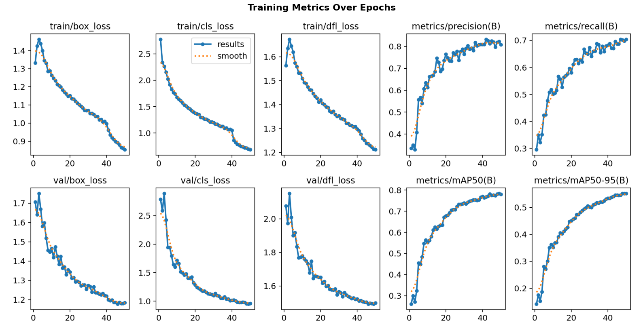
Model Training: Loss Curves & Convergence
01
04
Smooth Convergence
Best Model Saved
Training converged smoothly over 50 epochs with steady loss reduction
Best model automatically saved based on validation mAP performance
02
Loss Functions Decreased
All loss functions (box, cls, dfl) decreased steadily throughout training
03
No Overfitting
No signs of overfitting observed; validation metrics improved consistently

Slide 10





Validation Results: Strong Performance Achieved
78%
70%
55%
82%
mAP50
Recall
mAP50-95
Precision
Detection accuracy at 50% IoU threshold
Ability to find all weapons
Average precision across IoU 50-95%
Accuracy of positive predictions
Validated on 1,815 images with 2,963 weapon instances

Slide 11
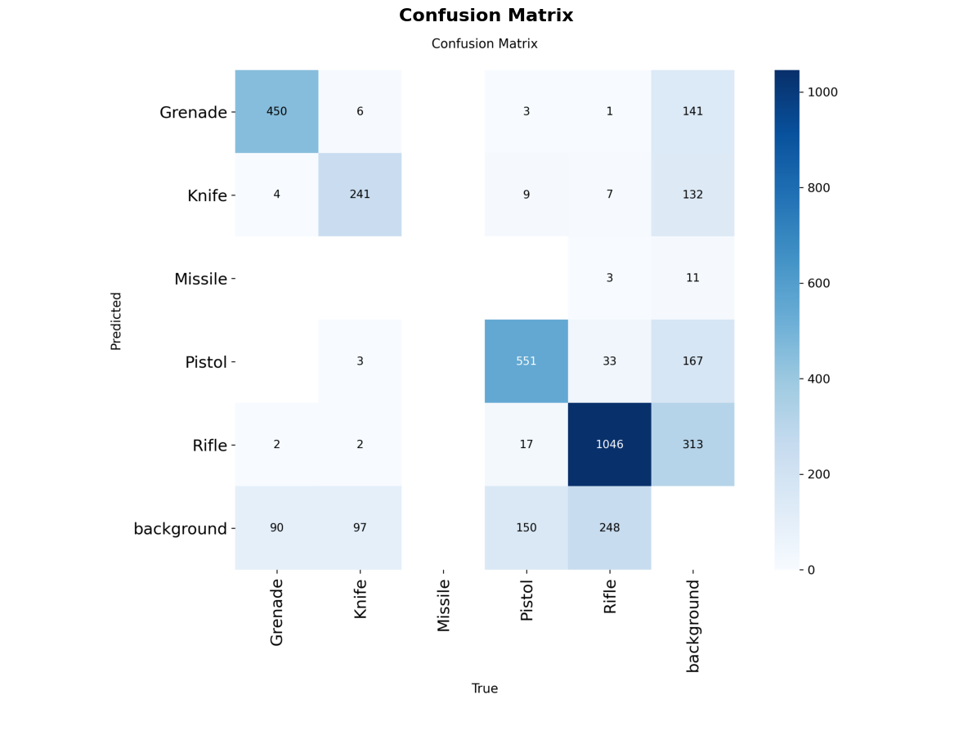
Model Confusion Analysis
Key Insights
The confusion matrix demonstrates robust classification performance with clear separation between weapon classes.
Strong diagonal indicating correct predictions
Minimal cross-class confusion between weapon types
Most errors are false negatives (missed detections)
Rare confusion between weapon types
Model is confident when it detects
Detailed matrix available in training notebook

Slide 12
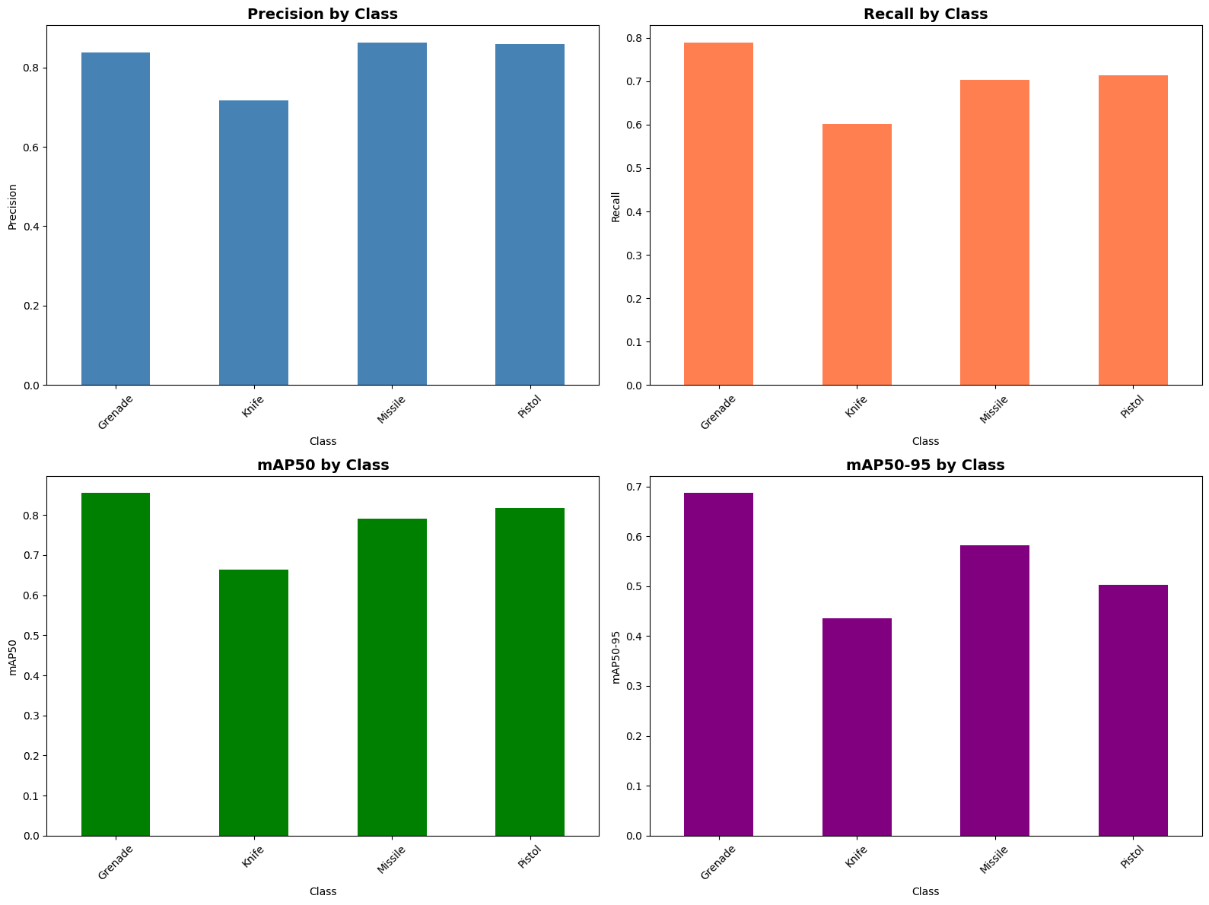
Per-Class Performance Analysis
1
2
Grenade
Knife
Precision: 0.88
Precision: 0.92
Recall: 0.85
Recall: 0.60
mAP: 0.87
mAP: 0.61
3
4
Missile
Pistol
Precision: 0.95
Precision: 0.95
Recall: 0.70
Recall: 0.73
mAP: 0.72
mAP: 0.94
5
Rifle
Precision: 0.90
Recall: 0.88
mAP: 0.89
The analysis reveals strong performance across most weapon classes, particularly for Pistols and Knives, which exhibit high precision and recall. Missiles show relatively lower scores, indicating a potential area for further model training and optimization. The consistent mAP scores across categories suggest a generally robust detection capability, with minor variations reflecting the inherent challenges of different object types.
Next: Real-world deployment considerations →

Slide 13
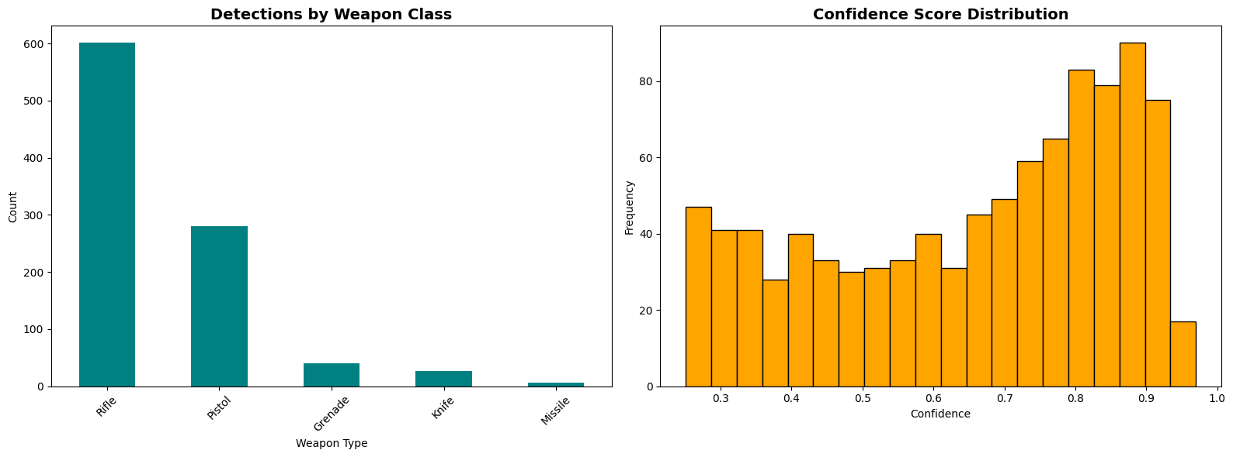
Detailed Performance by Weapon Type
Breaking down model accuracy across five weapon categories reveals strengths and opportunities for improvement.
Precision
Recall
mAP50
2,963
55.2%
Total Instances
mAP50-95
Training samples across all weapon types
Overall detection accuracy

Slide 14


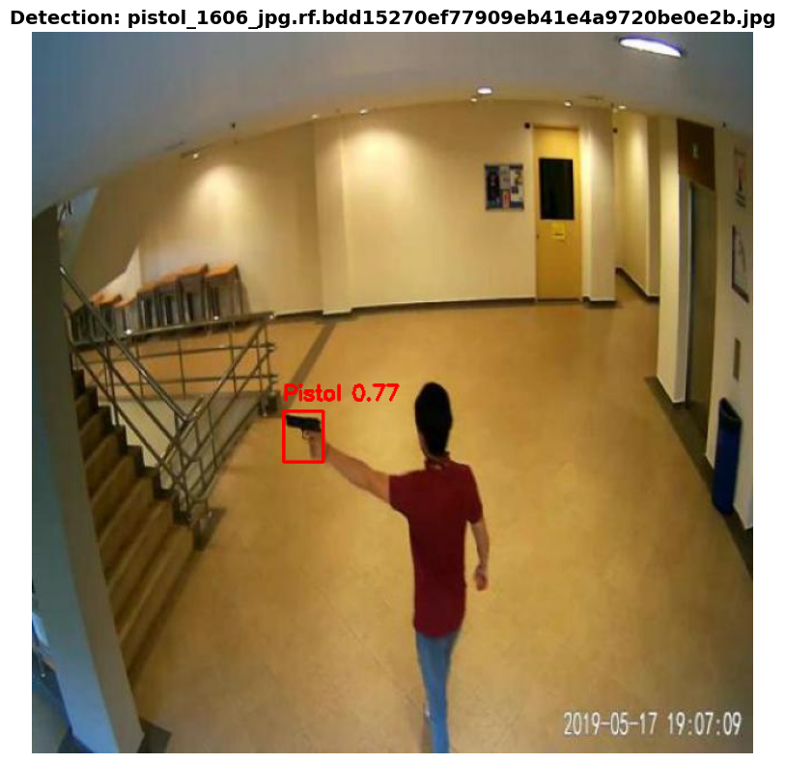
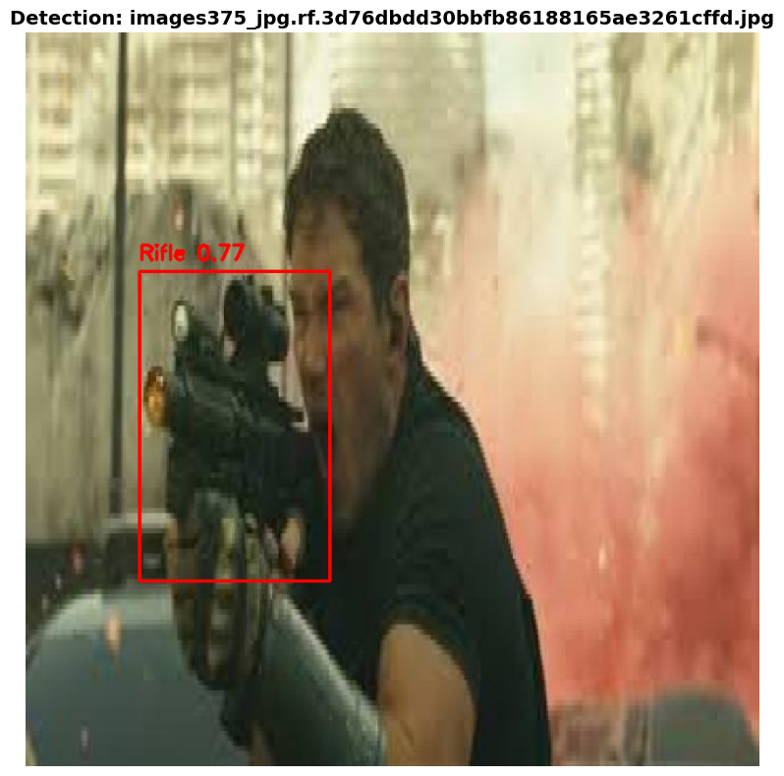

Real-World Testing: 636 Unseen Images
Model tested on completely unseen test set with 25% confidence threshold. Total of 957 objects detected across 636 images.
Visualized predictions on 30 sample images with bounding boxes drawn and confidence scores displayed. Visual inspection confirms accurate detections.
Red boxes show detected weapons with class labels and confidence scores
636
Test Images
957
Detections
75%
Confidence

Slide 15
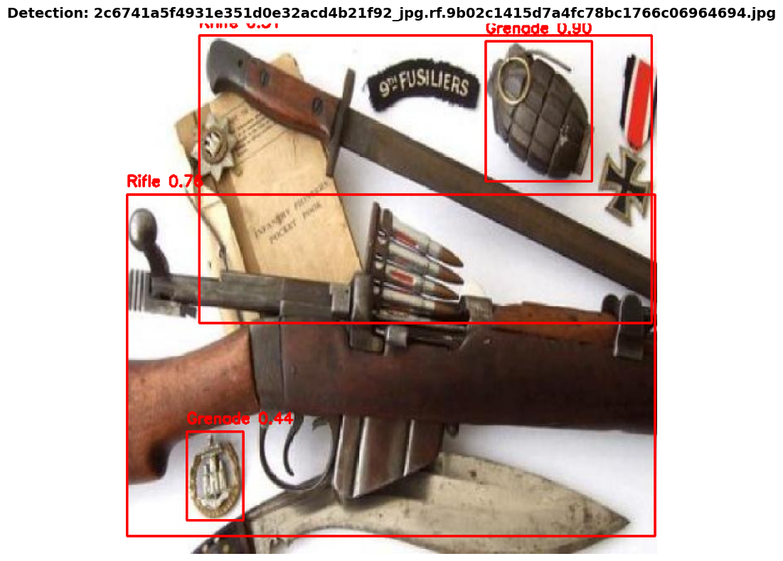
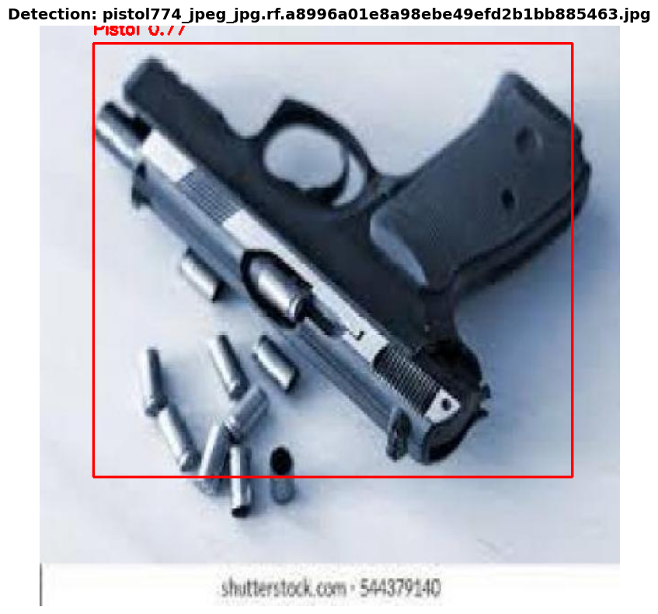

Slide 16
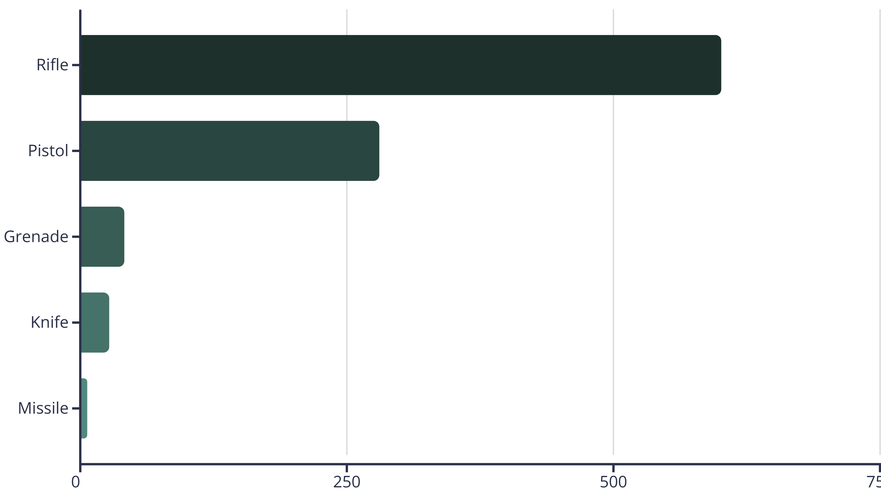
What the Model Found: Test Set Breakdown
Dataset shows strong class imbalance with rifles dominating real-world detection scenarios.
62.8%
29.4%
7.8%
Rifles
Pistols
Other Weapons
Dominant category
Second most common
Grenades, knives, missiles

Slide 17

Strengths and Areas for Improvement
Top Performers
Needs Improvement
1
Knife Detection
Grenade Detection
Lowest mAP50-95: 43.5%
Best overall: 68.7% mAP50-95
Recall only 60.2%
High precision: 83.7%
Challenges: Small size, less distinctive features
Most reliable detections
Missile Detection
2
Very limited data: only 7 test instances
Pistol Detection
Class imbalance issue
Strong precision: 86.3%
Good mAP50: 79.2%
Action needed: More knife and missile training data
3
Rifle Detection
High precision: 85.8%
Most training data: 1,338 instances

Slide 18








Model Export & Optimization
Model successfully exported to ONNX format for deployment across multiple platforms.
PyTorch Model
Original: 6.0 MB
ONNX Export
Optimized: 11.7 MB
Multi-Platform
Ready for production
ONNX Runtime
CPU/GPU deployment for flexible infrastructure
TensorRT
Optimized for NVIDIA GPU acceleration
OpenVINO
Intel hardware optimization
Mobile Deployment
iOS and Android compatibility

Slide 19
Beyond Images: Video & Live Detection
YOLOv8n processes at 30+ FPS on GPU, enabling real-time threat detection across multiple input sources.
Batch Image Processing
Video File Analysis
Real-Time Webcam Detection
Process entire folders of images with confidence scoring for each detection. Export results as CSV/JSON.
Frame-by-frame weapon detection. Output annotated video with bounding boxes and detection statistics per video.
Live surveillance integration with instant threat alerts. Ready for CCTV deployment.

Slide 20
Honest Assessment: Current Limitations
Transparent evaluation of challenges guides future improvements and realistic deployment expectations.
Class Imbalance
1
Missile severely underrepresented. Knife data limited.
Solution: Collect more balanced dataset
Recall Gap
2
70% recall means 30% of weapons missed. Trade-off between speed and accuracy.
Solution: Consider YOLOv8s/m for higher accuracy
Small Object Detection
3
Knives difficult to detect due to small size and variable appearance. mAP50-95 gap indicates IoU sensitivity.
Solution: Multi-scale training, data augmentation
Real-World Variability
4
Lighting, occlusion, camera angles create challenges. Need diverse training scenarios.
Solution: Continuous learning from deployment

Slide 21





Vision for Deployment: Smart Surveillance Network
Phase 1: CCTV Integration
Connect to existing IP camera networks. Real-time video stream processing with multi-camera monitoring dashboard and geographic mapping.
Phase 2: Alert System
Automatic threat detection alerts via SMS/Email. Integration with alarm systems and mobile app for security personnel.
Phase 3: Advanced Features
Person tracking with weapon. Threat level classification, historical analytics and reporting, AI-powered incident response.
Phase 4: Scalability
Cloud-based processing infrastructure. Edge AI for low-latency detection, multi-location deployment, integration with law enforcement systems.

Slide 22





Real-World Applications: Protecting Lives
AI can process 100+ cameras simultaneously, 24/7, with less than 1 second detection time.
Schools & Universities
Airports & Transportation
Corporate Buildings
Prevent active shooter situations with automatic lockdown triggers
Enhanced security screening and perimeter monitoring
Access control integration and visitor screening
Government Facilities
Retail & Public Spaces
High-security area monitoring and critical infrastructure protection
Shopping malls, stadiums, event venues with crowd safety management

Slide 23

AI for a Safer Tomorrow
Successfully Trained
Strong Performance
YOLOv8 weapon detection system
78% mAP50 and 82% precision
Production Ready
Real-World Ready
ONNX format for deployment
CCTV integration prepared
From 9,633 images → Trained model → 957 accurate test detections
Next Steps
01
02
03
Deploy pilot program in controlled environment
Expand dataset with more diverse scenarios
Integrate with existing security infrastructure
Thank You
Questions & Discussion Welcome

